Slide 1
Indian Key Commodities Retail

Slide 2
Team Members
M.M.SABARESH(RA2011003010781)
ADARSH VARDHAN SINGH(RA2011003010794)
ADITHYA DUTT KAMBHAMPATI(RA2011003011072)
SARVESH EKNATH MOTE(RA2011003011094)
MRITUNJAY KUMAR JHA(RA2011003011069)
PRIYANSHU JHA(RA2011003011071)

Slide 3
SOURCE DATA
This data was collected from OGD(Open Government Data Platform):-https://data.gov.in/ which happens to be the website home to many other data sets that are linked to the government of India
This Dataset contains 846,672 rows and 6 columns and contains the data of prices from 1975 to 2015
The 6 columns are :-
Date
Centre or city
Commodity
Price per kg
Region or state
Country
The size of the dataset is 39.6 MB

Slide 4
EXPECTED OUTPUT- STORYTELLING
The aim of analyzing the Indian retail commodity market could be to gain insights into the current state of the market, including trends, challenges, and opportunities. Some specific goals of such an analysis could include:
Understanding consumer behavior : Analyzing the retail commodity market in India could provide insights into consumer behavior, including preferences, buying habits, and spending patterns. This information could help retailers and manufacturers tailor their products and marketing strategies to better meet the needs of Indian consumers.
Identifying market trends: Analyzing the Indian retail commodity market could reveal emerging trends and shifts in consumer demand. This information could be useful for retailers and manufacturers who want to stay ahead of the curve and capitalize on new opportunities.

Slide 5
EXPECTED OUTPUT- STORYTELLING
Assessing competition: Analyzing the retail commodity market in India could help retailers and manufacturers understand their competition, including their strengths and weaknesses, pricing strategies, and market share. This information could be used to develop competitive pricing strategies and to differentiate products from competitors.
Improving supply chain efficiency: Analyzing the Indian retail commodity market could help retailers and manufacturers identify inefficiencies in their supply chains, such as delays in distribution or excess inventory. This information could be used to improve supply chain management and reduce costs.

Slide 6
WHO WILL BE INTERESTED?
Several stakeholders may be interested in the output of an analysis of the Indian retail commodity market, including:
Retailers: Retailers operating in the Indian market could be interested in the analysis output to understand consumer behavior, competition, and market trends. This information could help retailers make informed decisions about product assortment, pricing, and marketing strategies.
Manufacturers: Manufacturers of consumer goods could be interested in the analysis output to understand the demand for their products and the competition in the market. This information could help manufacturers optimize their production processes and product offerings to better meet consumer needs.

Slide 7
WHO WILL BE INTERESTED?
Investors: Investors interested in the Indian retail market may want to analyze the market to identify investment opportunities, potential risks, and growth prospects. This information could help investors make informed decisions about where to invest their capital.
Government agencies: Government agencies responsible for regulating the retail industry in India may be interested in the analysis output to understand the overall health of the market and identify areas where regulation may be necessary.
Academics and Researchers: Academics and researchers studying the Indian retail commodity market may be interested in the analysis output to gain insights into consumer behavior, market trends, and other factors that may affect the industry. This information could be used to develop new theories or test existing ones.

Slide 8
Ipython Visualisations

Slide 9
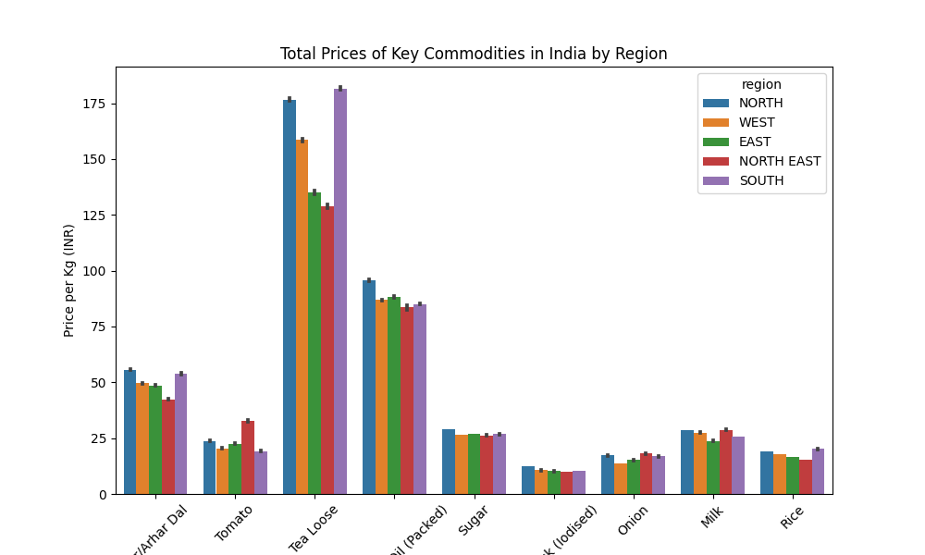
Bar graph

Slide 10
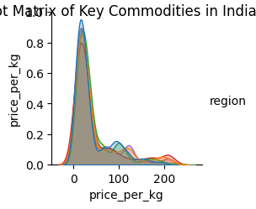
Scatter Plot matrix

Slide 11
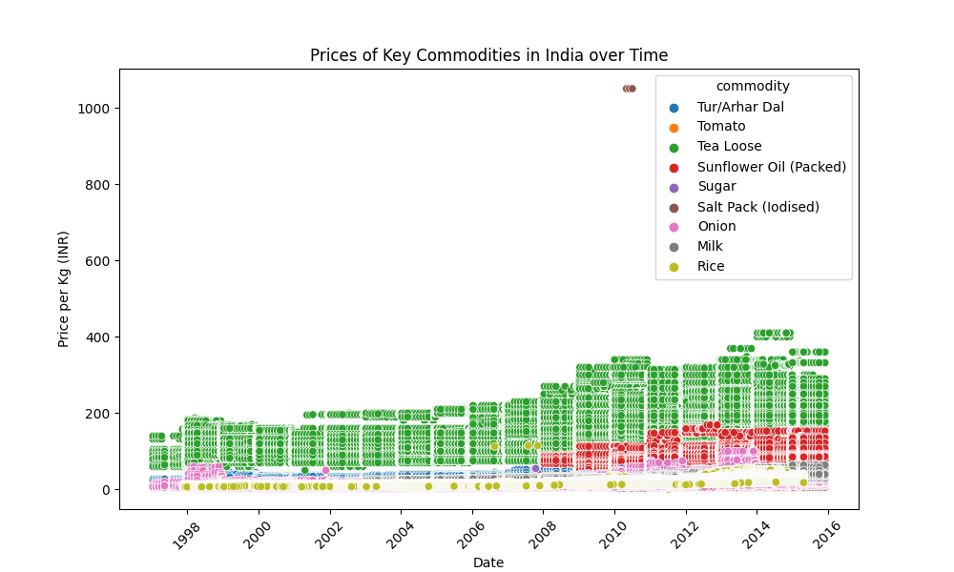
Scatter Plot

Slide 12
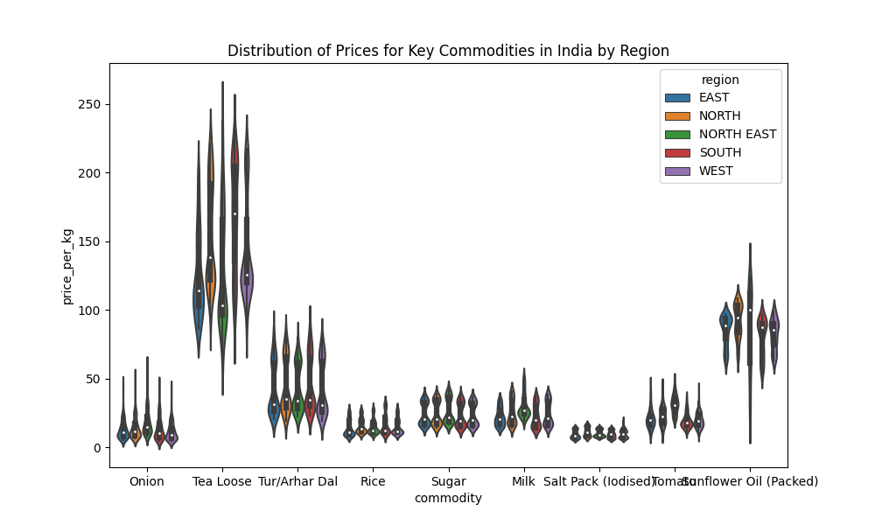
Violin Plot

Slide 13
Tableau Visualization

Slide 14
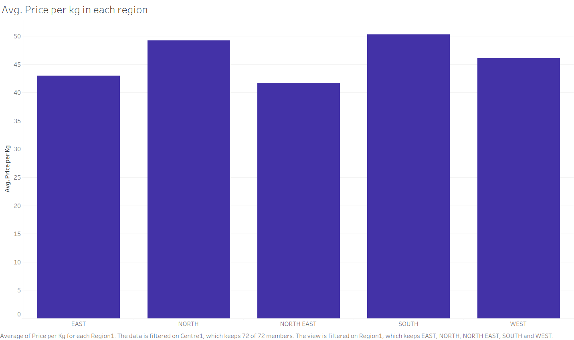
Average Price per kg in each Region
Sothern Region has the highest average price per kg of all commodities.
Northeastern Region has the lowest average price per kg of all commodities.

Slide 15
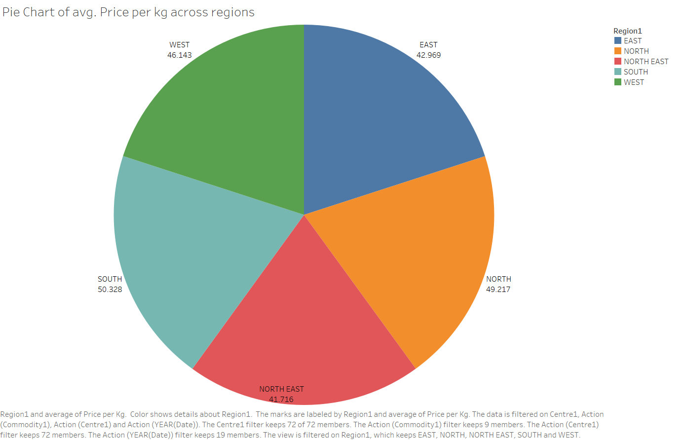
Pie Chart of avg Price per kg across Regions

Slide 16
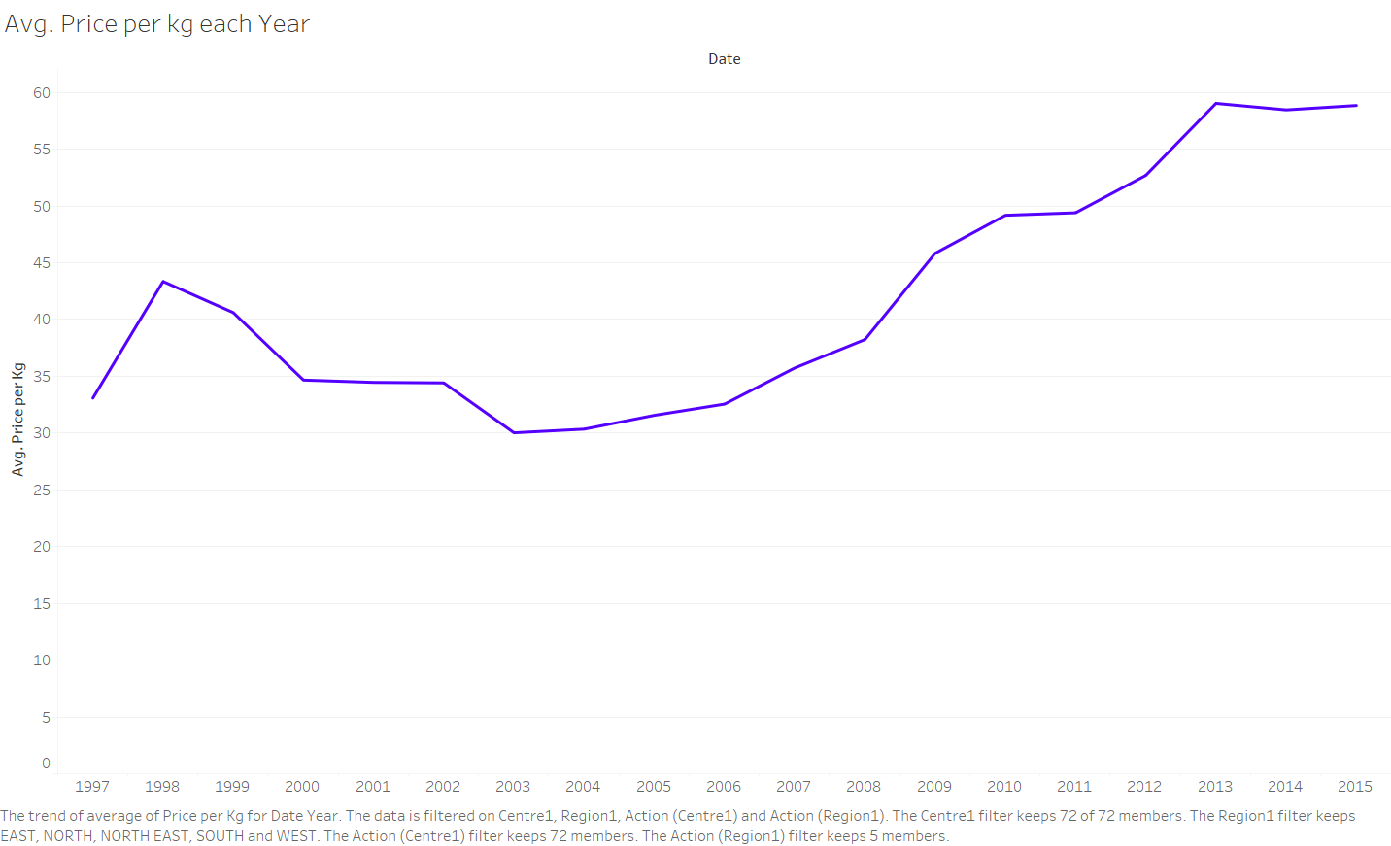
Average Price per kg each Year
There was a slight decrease of average price between the years 1998-2003.
Since 2003, there is a steady growth in the average price per kg.

Slide 17
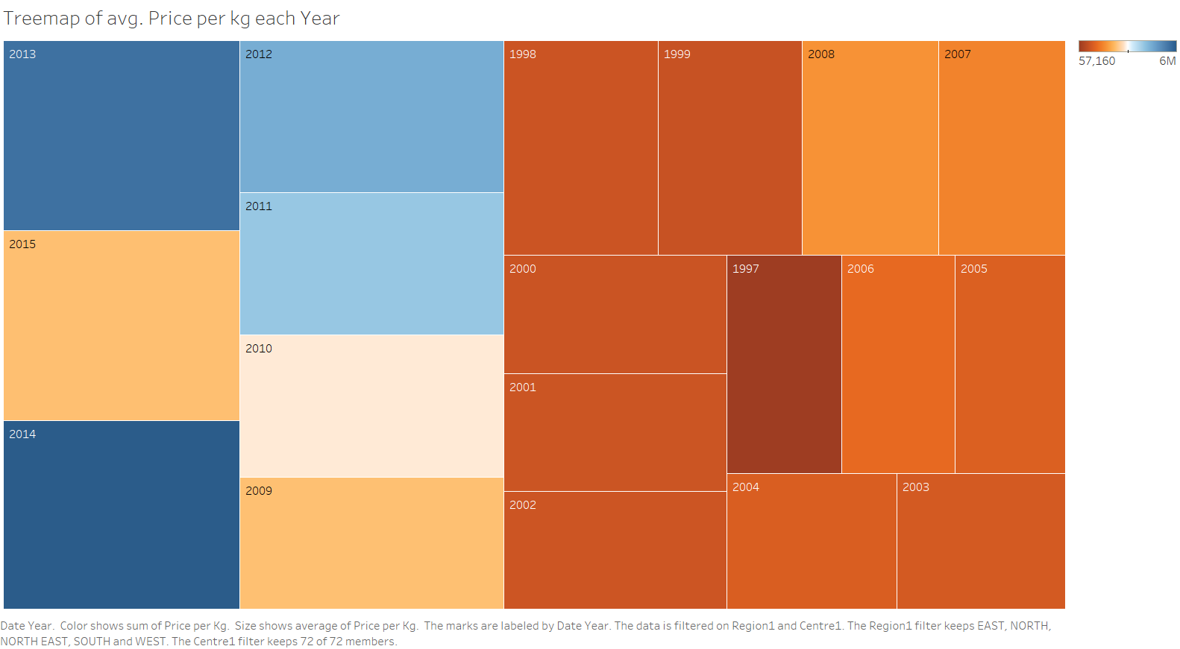
Tree map of avg. Price per kg each Year
Another representation to show that the average price were higher after 2009.
It also tells us that the average price before 2000 were greater than average price during 2000-2007.

Slide 18
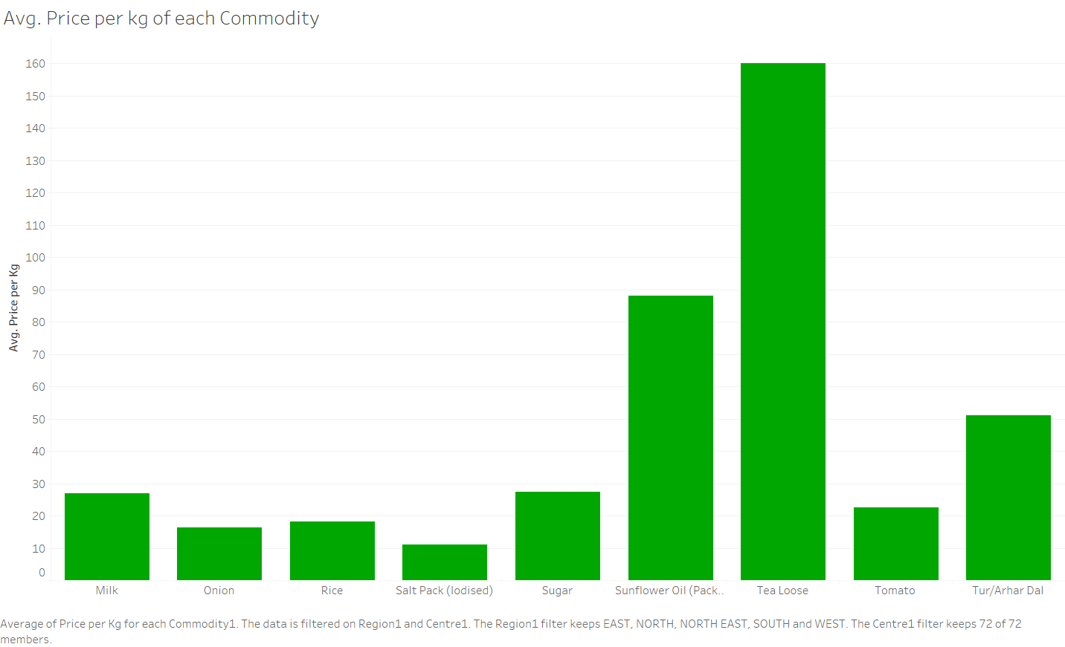
Avg. Price per kg of each Commodity
Tea has the highest average price per kg.
Iodized Salt has the lowest average price per kg.

Slide 19
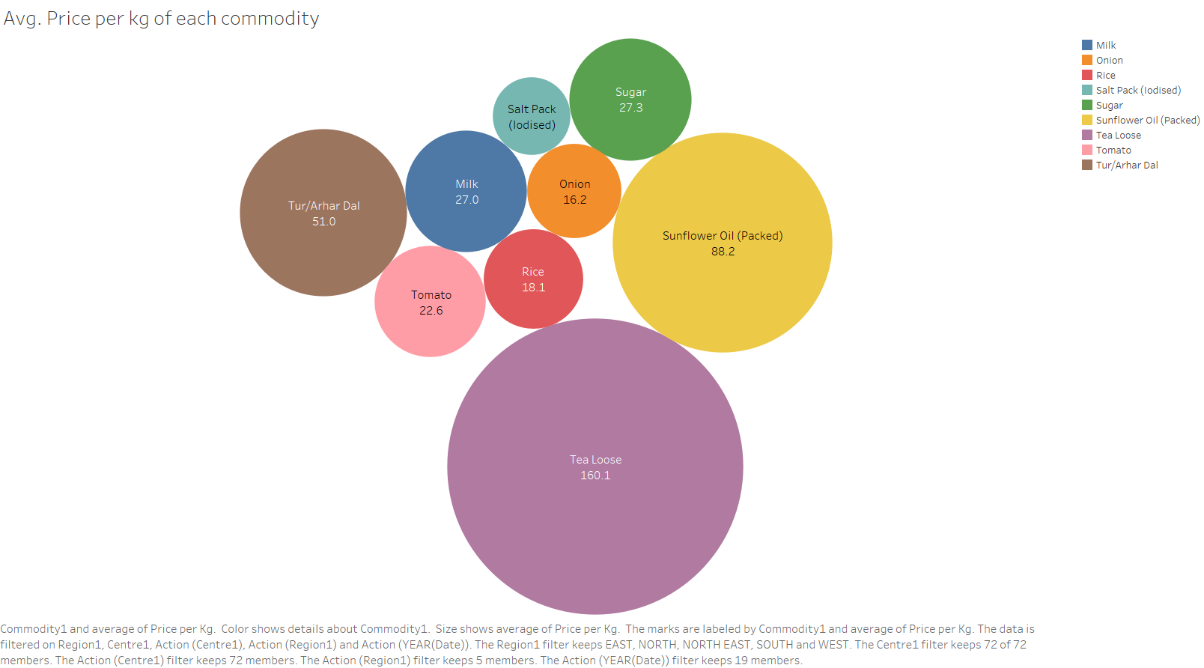
Avg. Price per kg of each Commodity

Slide 20
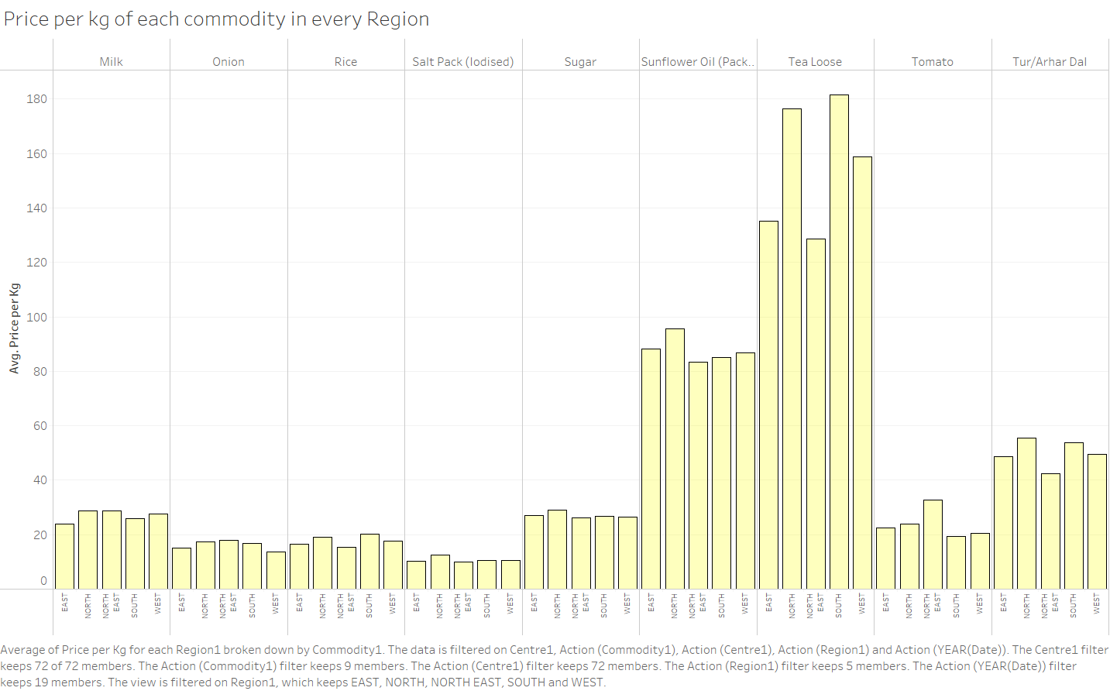
Price of each commodity in every Region
More detailed average price per kg of each commodity.
The Sothern region has the highest average price per kg of tea and Northeastern region has the lowest.
The Northeastern region has the lowest average price per kg of iodized salt and Sothern region has the highest.

Slide 21
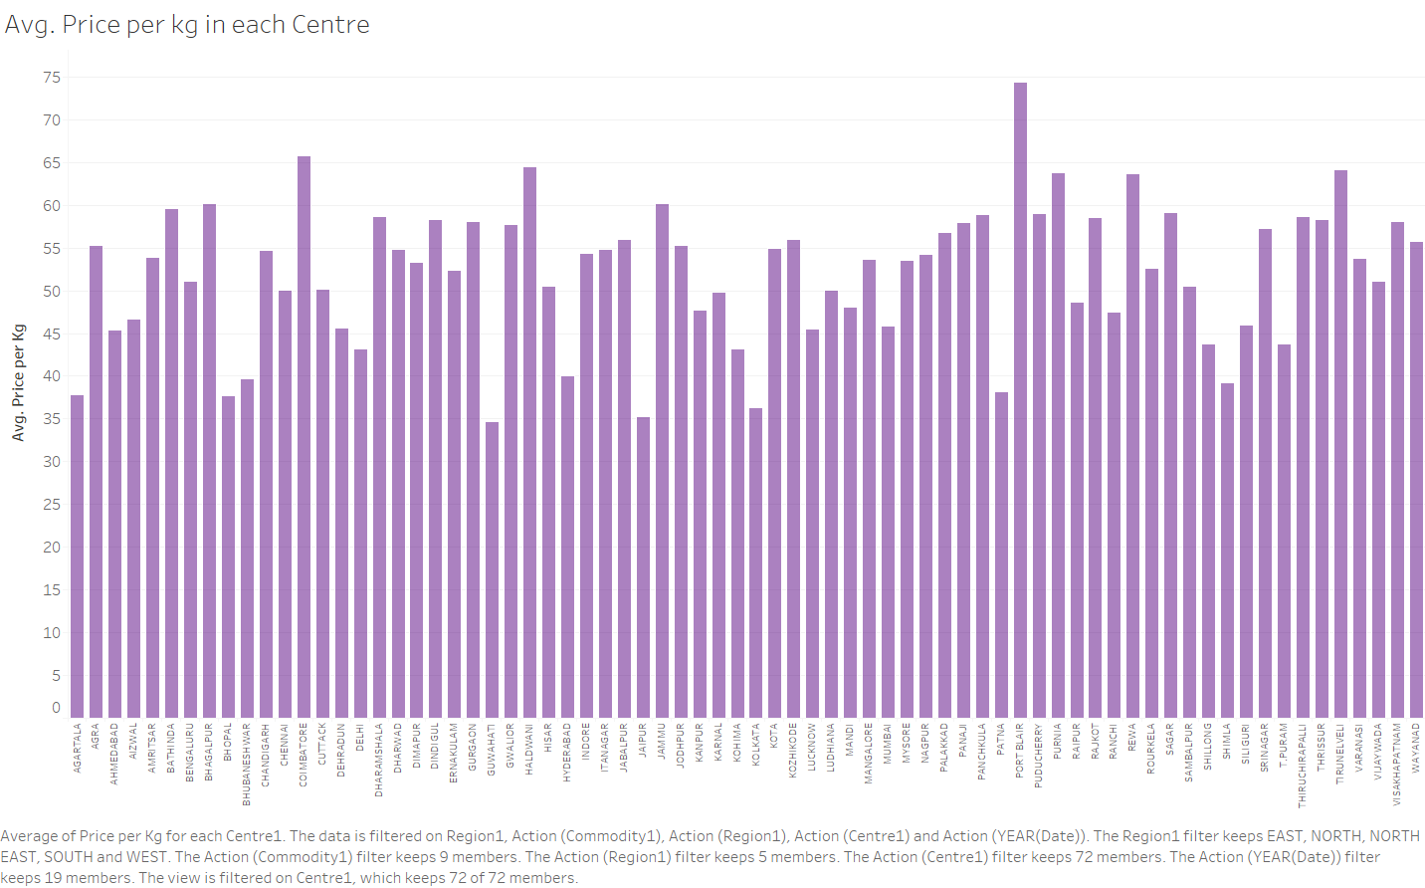
Average Price per kg in each City
Port Blair has the highest average Price per kg.
Guwahati has the lowest average Price per kg.

Slide 22
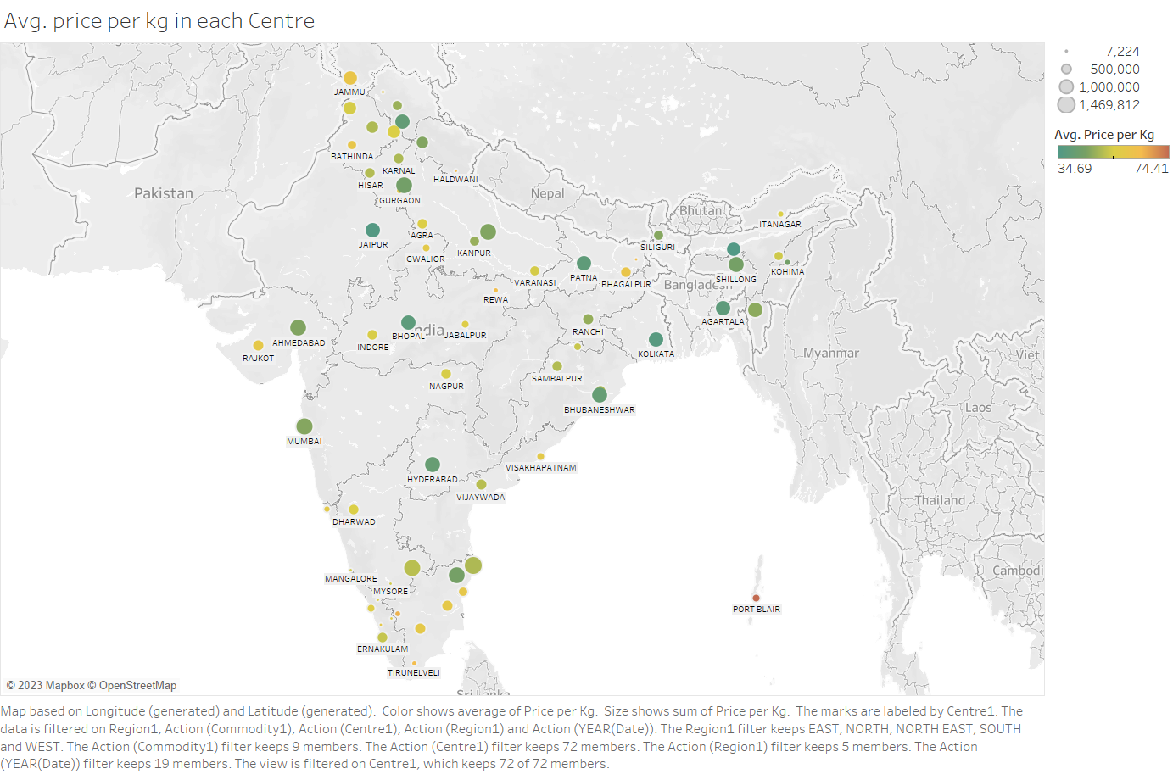
Symbol map for average price in each city
Hi
hi

Slide 23
Tableau Dashboard

Slide 24
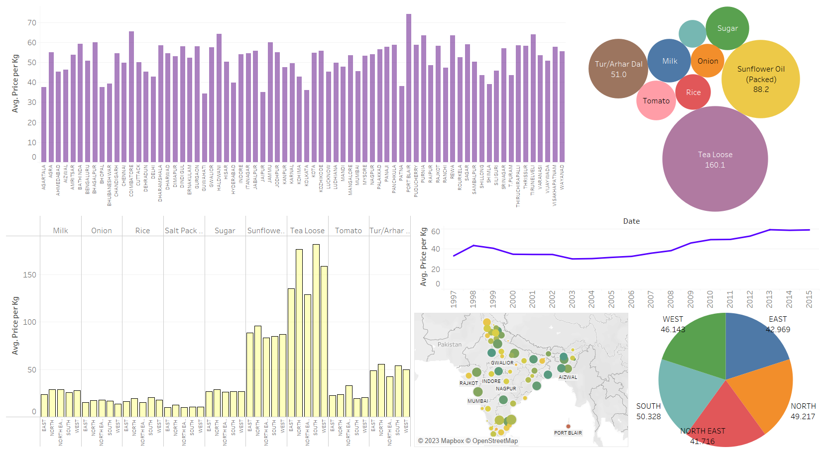

Slide 25
Visualisation through D3 Js

Slide 26
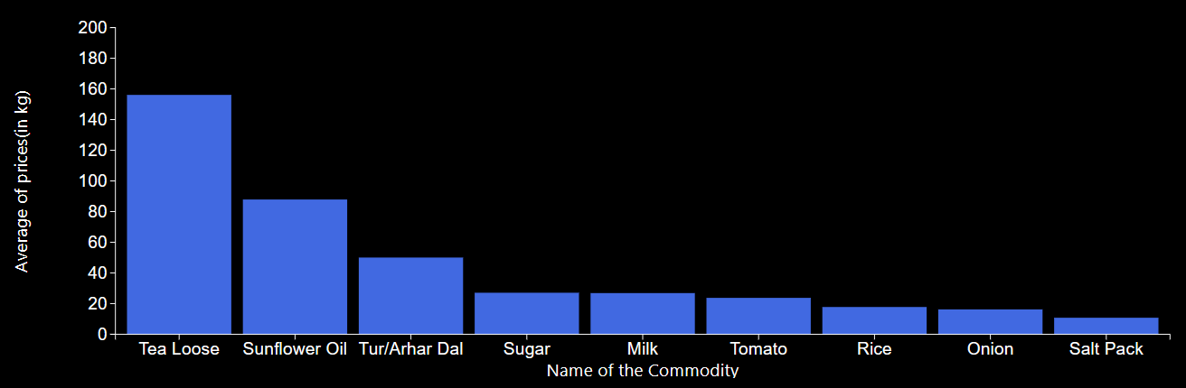
D3 Visualisation

Slide 27
Description…
The above visualisation is made through D3 js .
Name of commodity vs Average of prices(in kg) Bar graph is formed.
The average of prices of all five regions (i.e) North, South, East, West and North-East is summed up to get the basic idea of the price range.
All the nine commodities in our dataset are used to construct the visualisation .
From the above visualisation we can conclude that Tea Loose has highest average price and Salt Pack have lowest price.

Slide 28
Thank You

